Slide 1
Exploratory Data Analysis of City Car-Sharing Rentals Operational Insights & Charging Optimization
Dataset: Car-sharing rental data (last 365 days)
Tools Used:
Python (Pandas, Matplotlib, Seaborn)
Tableau (Interactive dashboards)
SQL (Data Querying)
Prepared by: Jenifer Henry Dominique

Slide 2
Project Objective
Vehicle Rental
↓
Battery Usage
↓
Charging Station
↓
Operational Decision
The goal of this analysis is to understand how vehicles are used in a city car-sharing system and identify opportunities to improve operational efficiency.

Slide 3
Dataset Description
Column | Description
VEHICLE_ID | Unique vehicle identifier
MODEL_ID | Vehicle model
STARTED_TIME | Rental start timestamp
FINISHED_TIME | Rental end timestamp
CHARGELEVELSTART | Battery level at start
CHARGELEVELEND | Battery level at end
CHARGED | Vehicle was plugged into charger
SERVICERENTAL | Rental performed by service agent
The dataset contains rental records for vehicles used in a city car-sharing system.

Slide 4
Analytical Approach
1️⃣ Fleet Utilization Analysis
Identify peak rental periods
Understand demand patterns
2️⃣ Battery Behaviour Analysis
Study battery levels at rental start
Understand customer battery preferences
3️⃣ Charging Optimization
Analyse charging events
Detect charging interruptions
Evaluate service agent interventions
The analysis was conducted in three main stages:

Slide 5
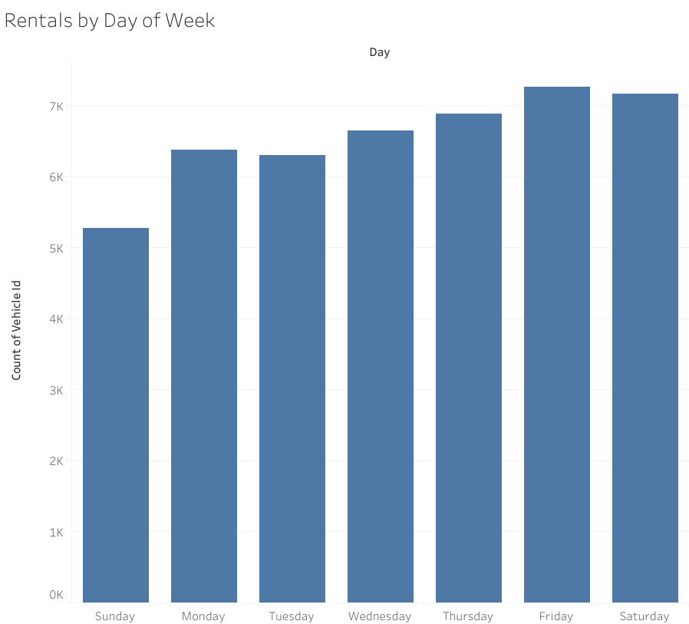
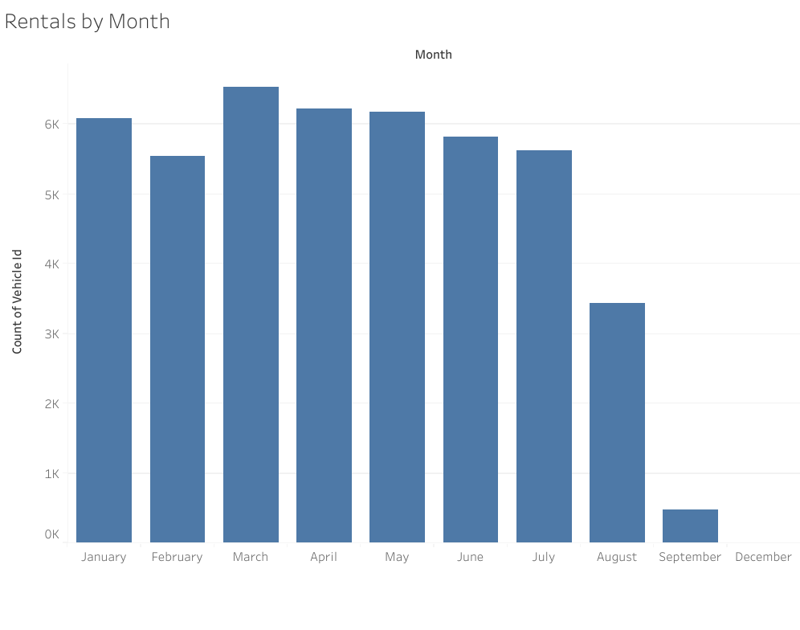
Fleet Utilization Patterns
Findings
Rental activity varies significantly across days of the week.
Customer rentals and service rentals show different usage patterns.
Monthly rental trends reveal seasonal variations in demand.
Insight
Understanding peak demand periods can help optimize vehicle distribution and availability.

Slide 6
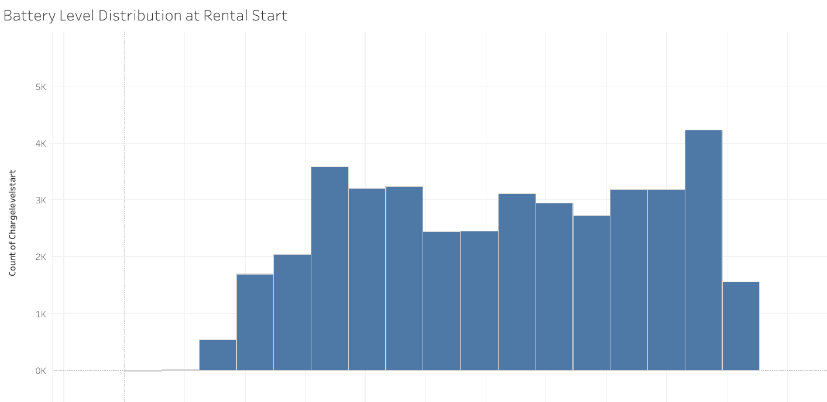
Customer Battery Preferences
Findings
Customers tend to rent vehicles with moderate battery levels.
Rentals are less frequent at very low battery levels
Insight
Battery availability influences customer rental decisions.
Maintaining vehicles within preferred battery ranges improves fleet usability.

Slide 7
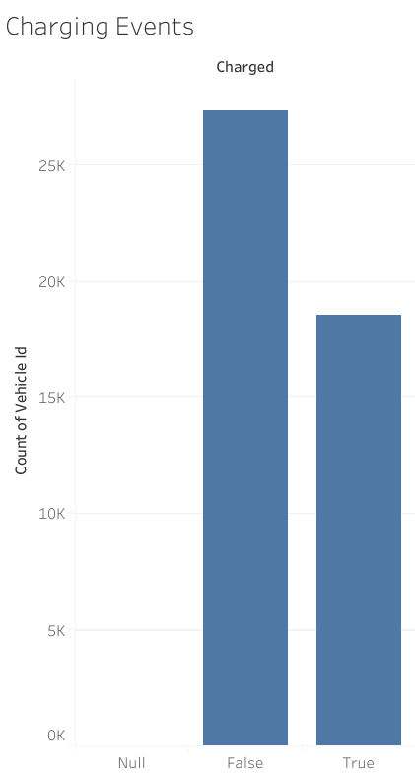
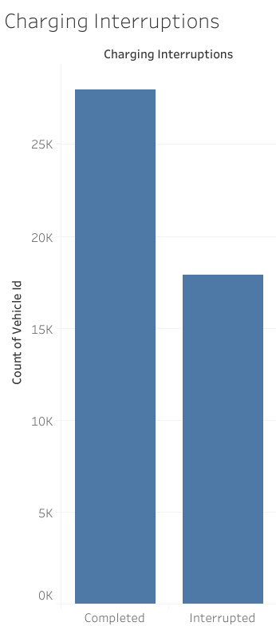
Charging Events and Interruptions
Findings
Charging interruptions occur when:
Vehicle is plugged into a charger but does not reach 100% battery.
Customers rent the vehicle before charging completes.
Insight
Charging interruptions indicate high vehicle demand but inefficient charging usage.

Slide 8
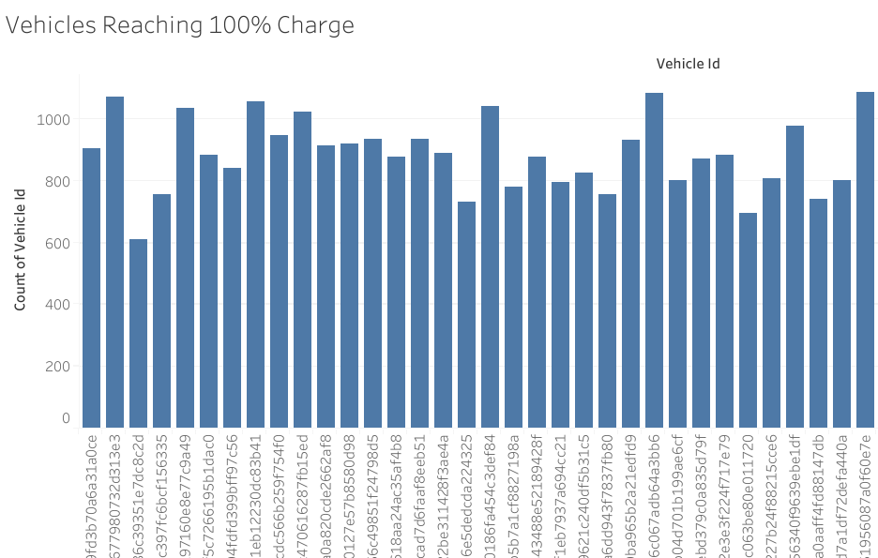
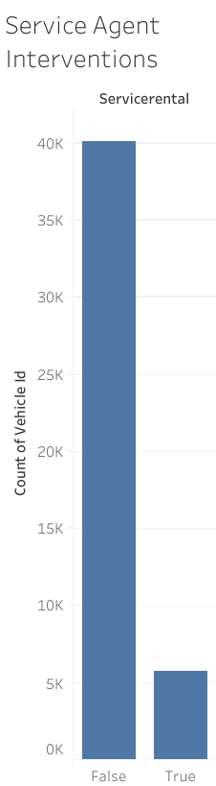
Charging Efficiency & Operational Interventions
Findings
Some vehicles frequently reach full charge, occupying charging stations longer.
Service rentals represent operational activities such as vehicle relocation and charging.
Insight
Operational interventions play an important role in maintaining fleet readiness and charger availability.

Slide 9
Operational Recommendations
Move vehicles from charging stations once an optimal battery level is reached to avoid idle charging fees.
Use rental demand patterns to position vehicles in high-usage locations and peak times.
Monitor charging interruptions to improve charging schedules and vehicle availability.
Implement dashboards to track fleet utilization, charging events, and operational activity.
Use data insights to support service agents in making faster fleet management decisions.

Slide 10
THANKYOU
Any queries

